Slide 1
Selected Highlights from the Moments Discussions
W.J. Llope for the attendees
5/24/2012
Thanks very much to the speakers and attendees for the
lively and very interesting discussions!
This is not a “summary” of the workshop so far.
Many important details are of course available in the talks…
http://drupal.star.bnl.gov/STAR/conference/timetable/talk/24194

Slide 2
Cebra
R1,R2,R3 = 1 if no critical behavior or if entirely critical behavior
R4,R5 = 0

Slide 3
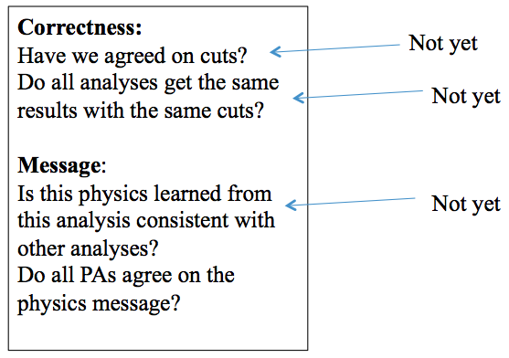
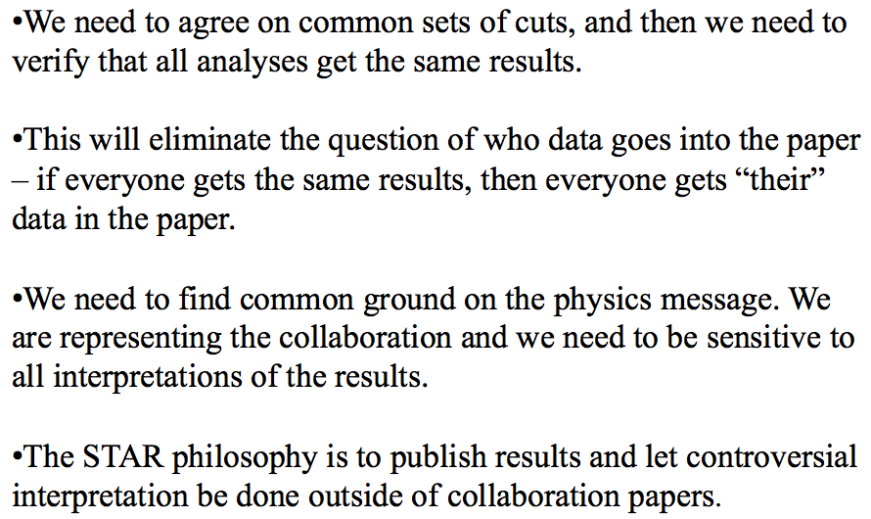
Cebra

Slide 4
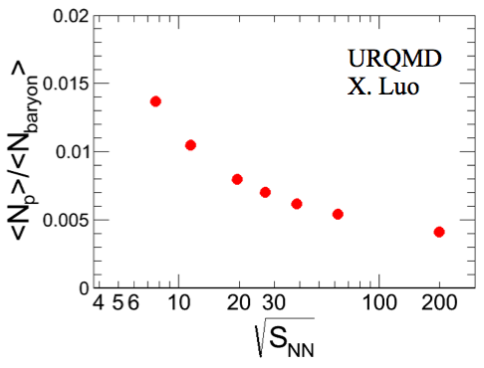
Koch
“p” is generally rather small. Study moments with different “p” values…
Wider cuts might introduce other effects (PID, backgrounds, e,y dependence)

Slide 5
Koch

Slide 6
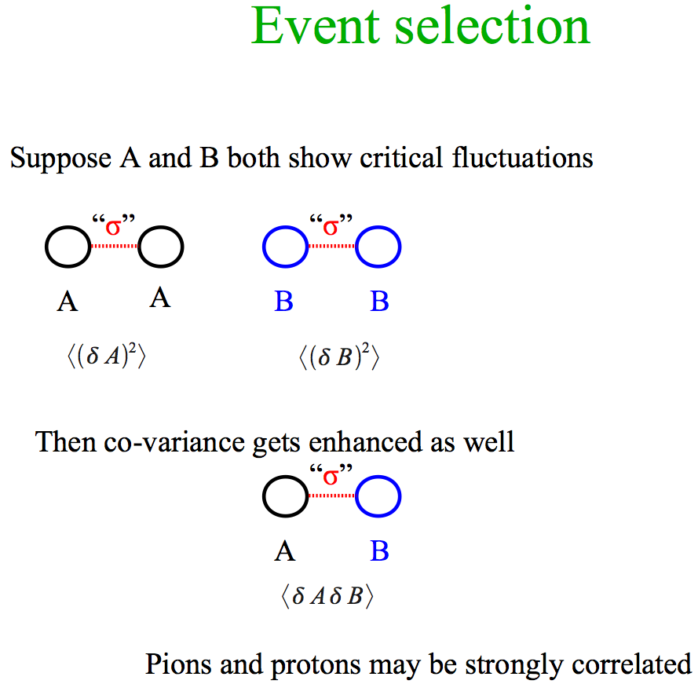
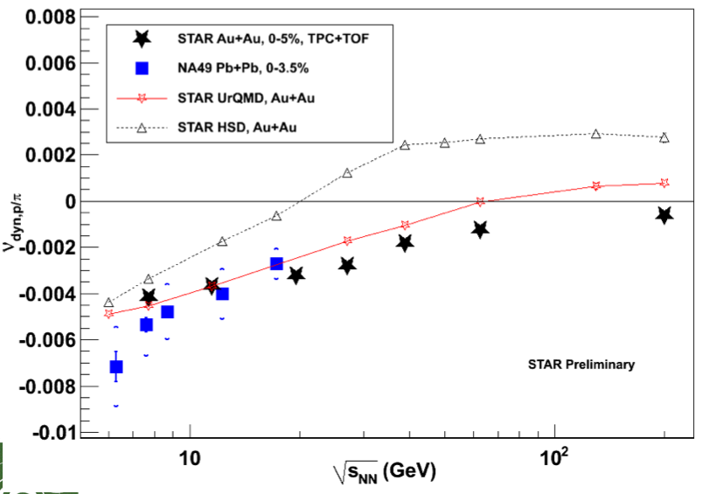
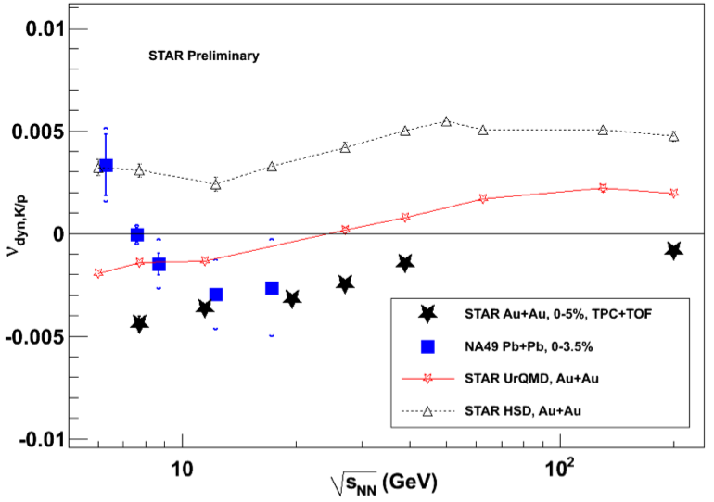
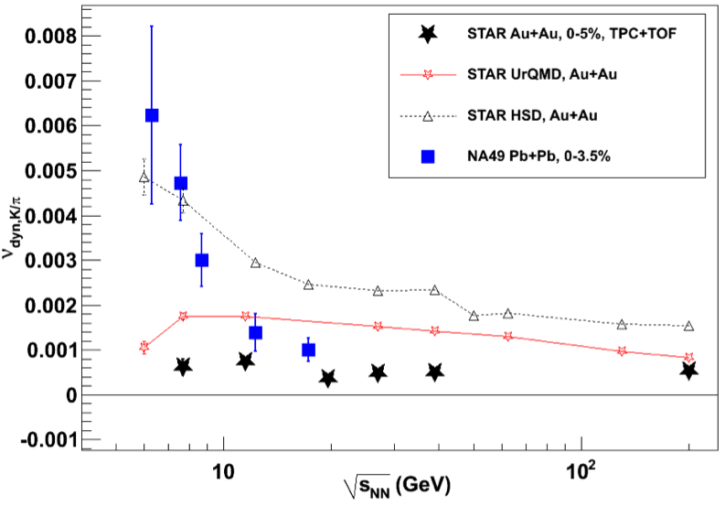
Koch & Tarnowsky
p/π
correlation
K/p
correlation
fluctuation
K/π
Residual Autocorrelation in refmult3?

Slide 7
Koch
Light nucleus integrated yield ratios….. d/(pp), t/(dp), He³/(dp)
Effect lives at low P_{T}, can signal survive our spallation cut?

Slide 8
Stephanov
Lattice rules out μ_{B}^{crit} < 200 MeV
General consensus that μ_{B}^{crit} < 500 MeV

Slide 9
Koch & Stephanov
“can bend
back over”

Slide 10
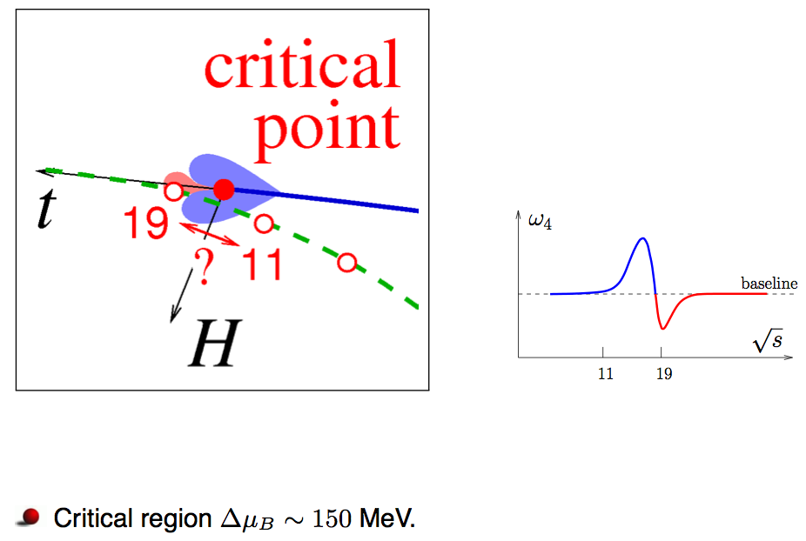
Stephanov
peak/|trough| ~30 at most,
but can be a lot smaller
μ_{B}^{crit} > 200 MeV
@ 19.6, 11.5, and 7.7
(Δμ_{B} = 100 MeV in Athanasiou et al.)

Slide 11
Stephanov

Slide 12
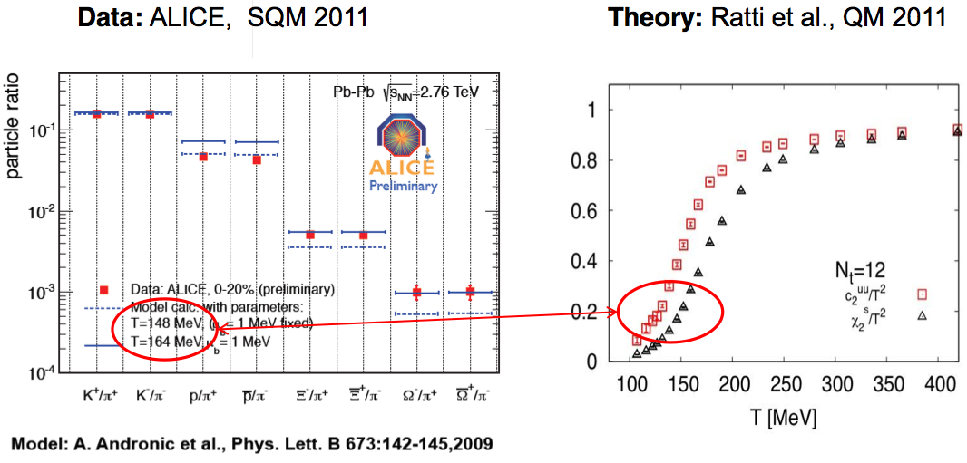
Bellwied
….not really “moments,” but generated lots of discussion….

Slide 13
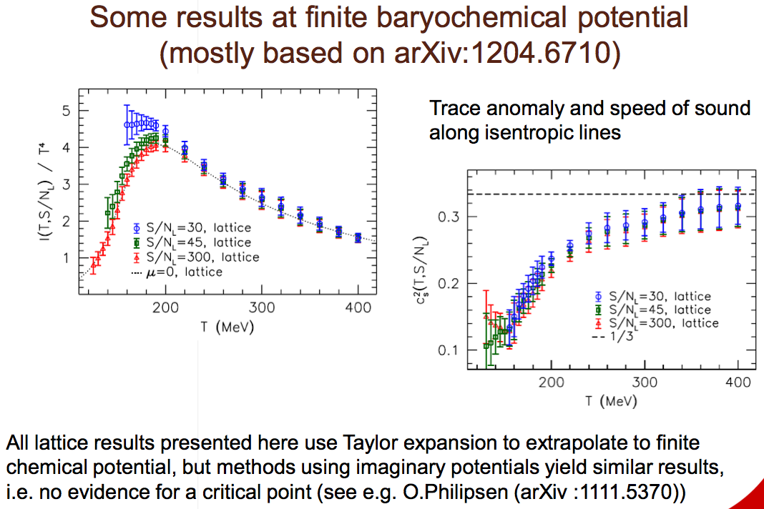
Bellwied

Slide 14
EXPERIMENTAL
will not attempt to show all of the results….
I concentrate on pointing out
track cuts…
event cuts…
bad-run & bad-event rejection…
and then 1-2 “major results” plots from each talk…

Slide 15
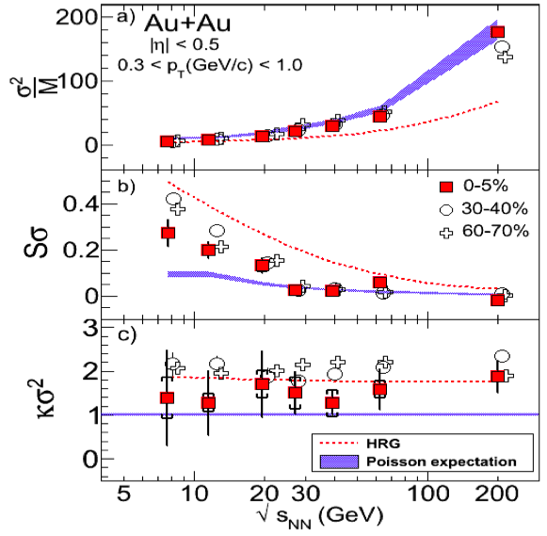
Sahoo (net-charge)
background cut: refmult vs tofmatch only….
should stop using Run-10 200, use Run-11 200 instead…

Slide 16
Westfall

Slide 17
Westfall

Slide 18
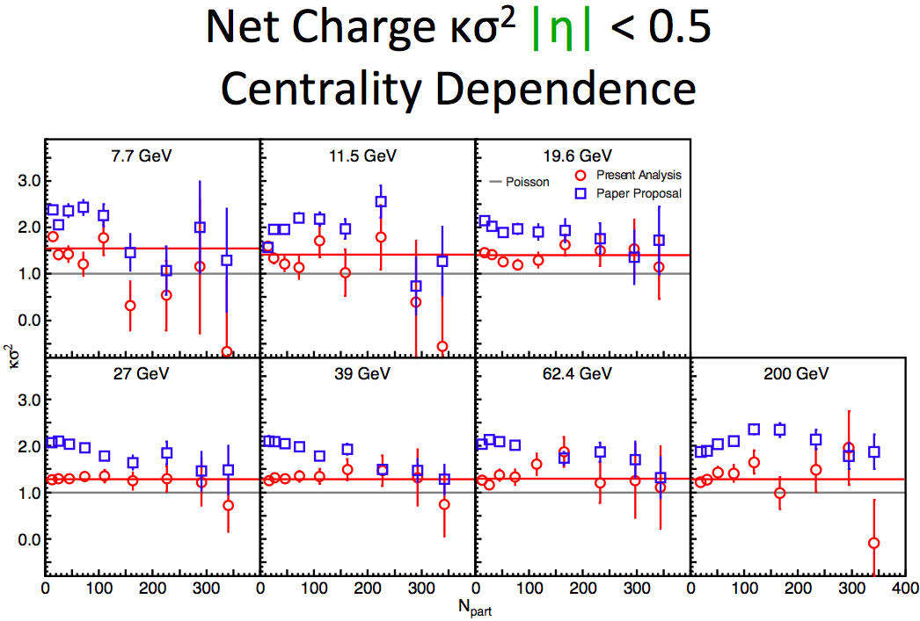
Westfall

Slide 19
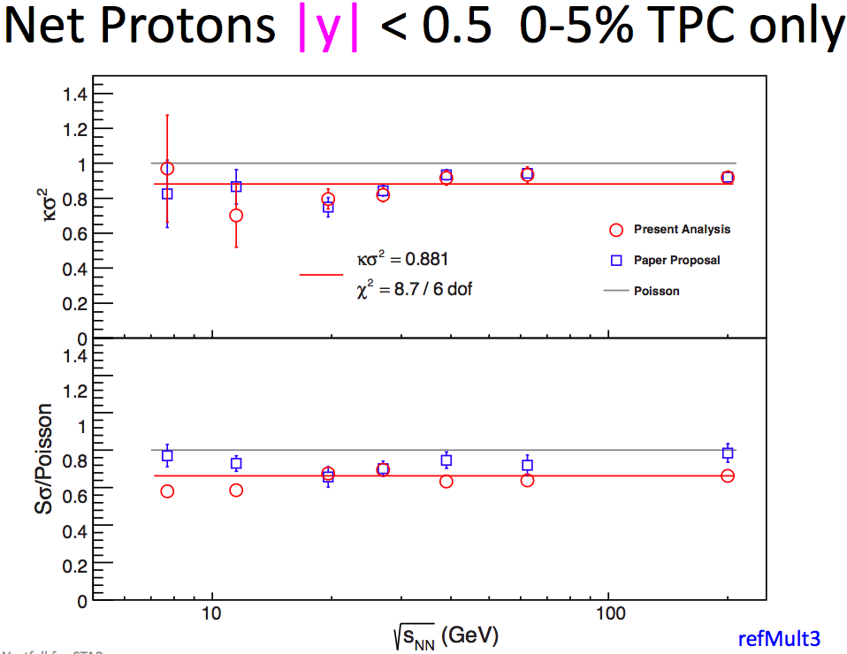
Westfall
refmult3
|y|<0.5

Slide 20
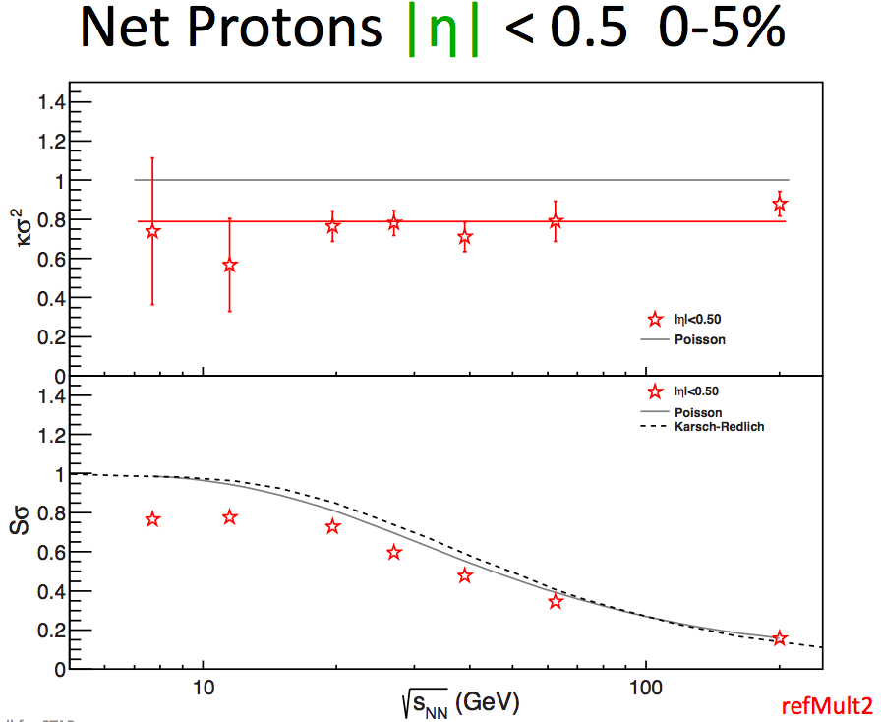
Westfall
refmult2
|η|<0.5

Slide 21
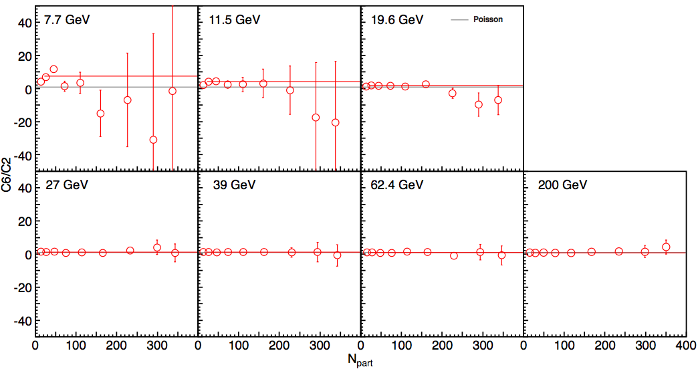
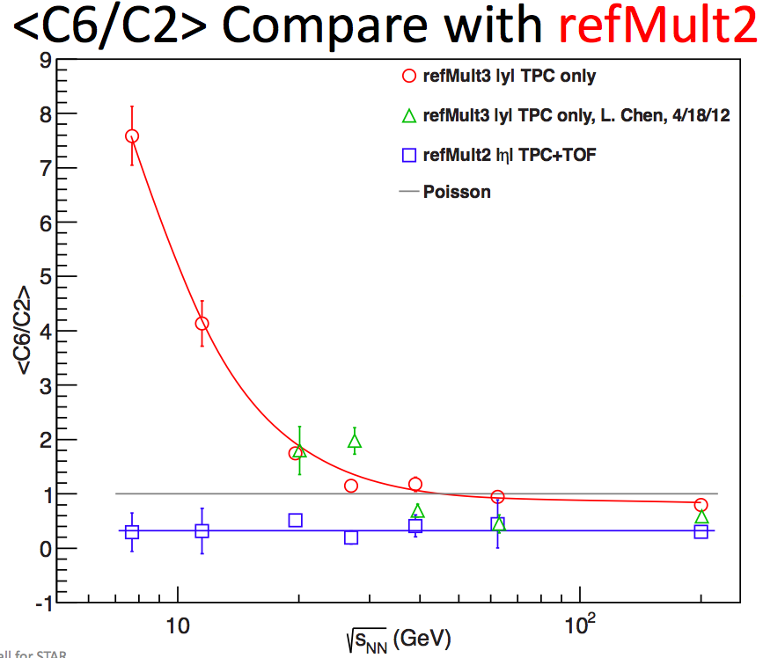
Westfall

Slide 22
McDonald

Slide 23
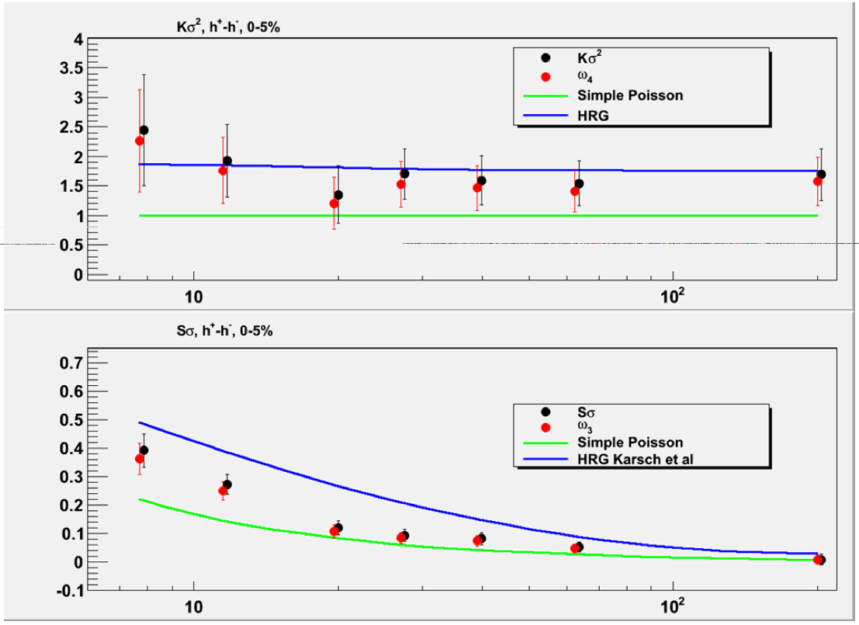
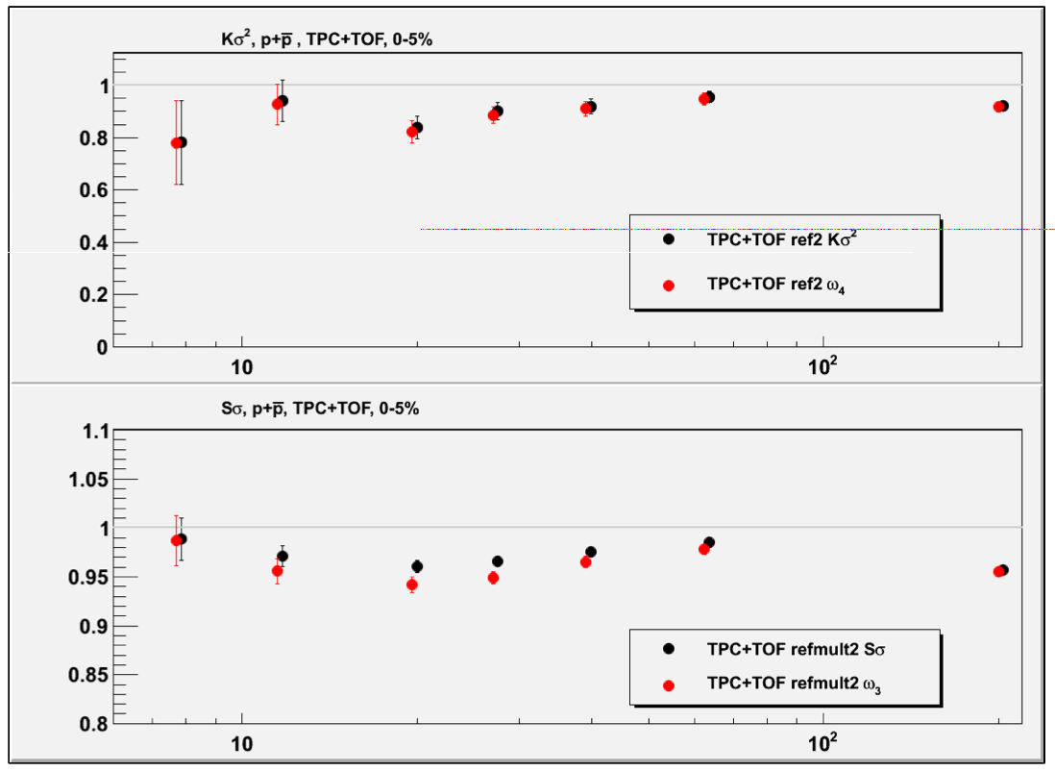
McDonald
net charge…
…total protons

Slide 24
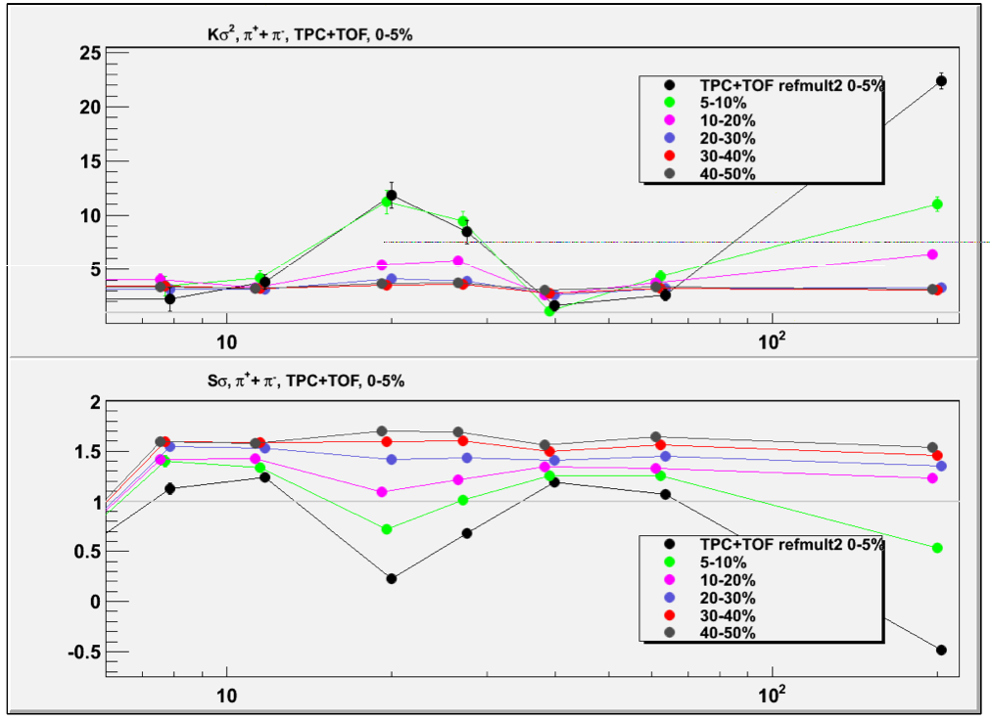
McDonald
total pions

Slide 25
Luo

Slide 26
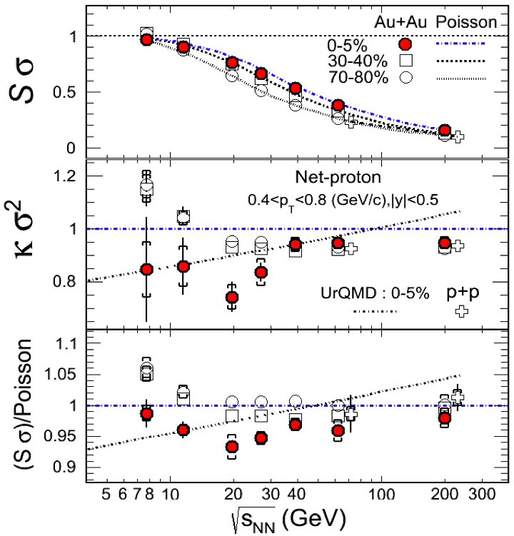
Luo
refmult3
|y|<0.5

Slide 27
Chen

Slide 28
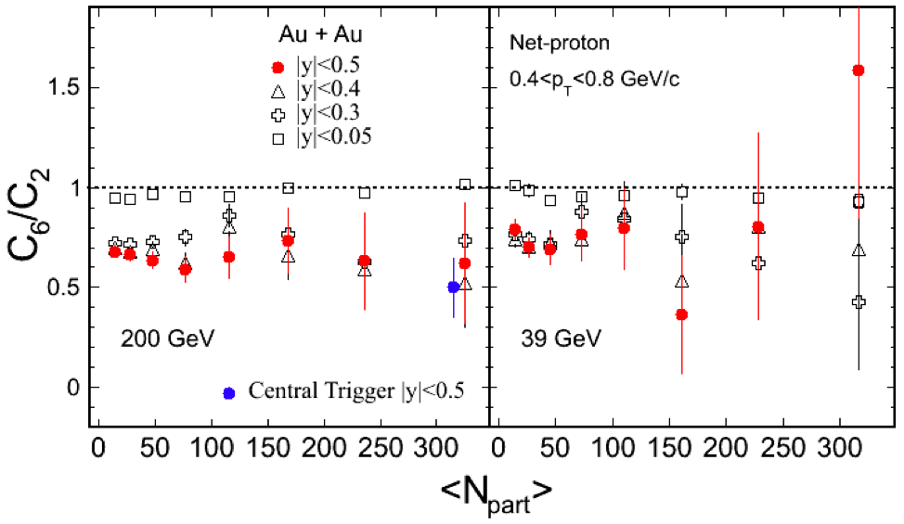
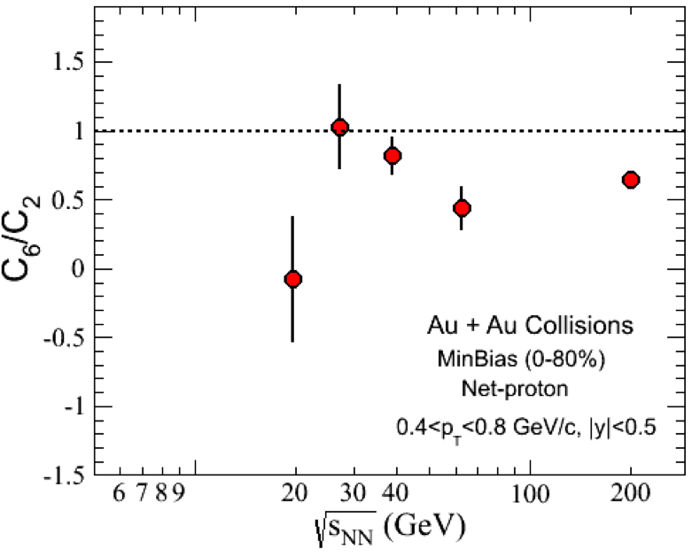
Chen

Slide 29
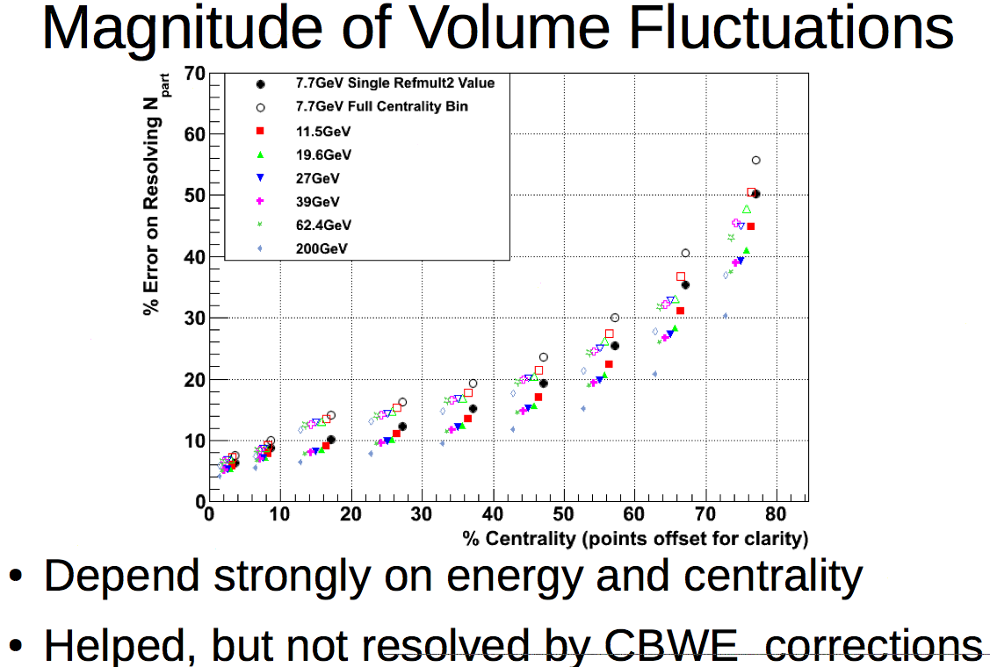
Sangaline
Npart as “centrality”
Npart width ~ centrality resn
σ(Npart)/μ(Npart)
in centrality classes
based on refmult2

Slide 30
Sangaline

Slide 31
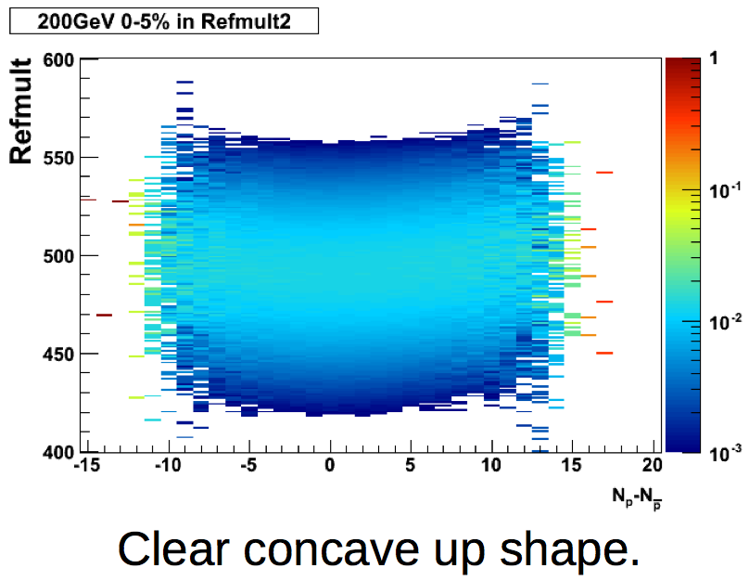
Sangaline
visual indication of autocorrelation
between N and refmult?
refmult2?
refmult3?

Slide 32
Big Picture (My View)
Tremendous progress. Beautiful results. All should be congratulated on their hard work.
However, some big differences in the analyses…
Some bad-run and bad-event rejection criteria are v. loose, some are v. tight…
refmult2corr (|η|<0.5) vs refmult3corr (|y|<0.5)…
Gary - CBW correction weight?
Nihar - spallation cut? multivariate background rejection?
Daniel - QA run11 200? numerical stability?
Xiaofeng - |Zvtx| range @ 7.7? tighter background rejection? data/skellam tight RM cut?
Lizhu - bad-event cut bands? Order of bad-run/evt/trk cuts? b-dep. of rejected evts?
Evan - implementation?
Sigma-field is isospin blind: “net-” moments vs “total-” moments?

